Slide 1



Title: Sentiment Analysis on movie reviews

Slide 2
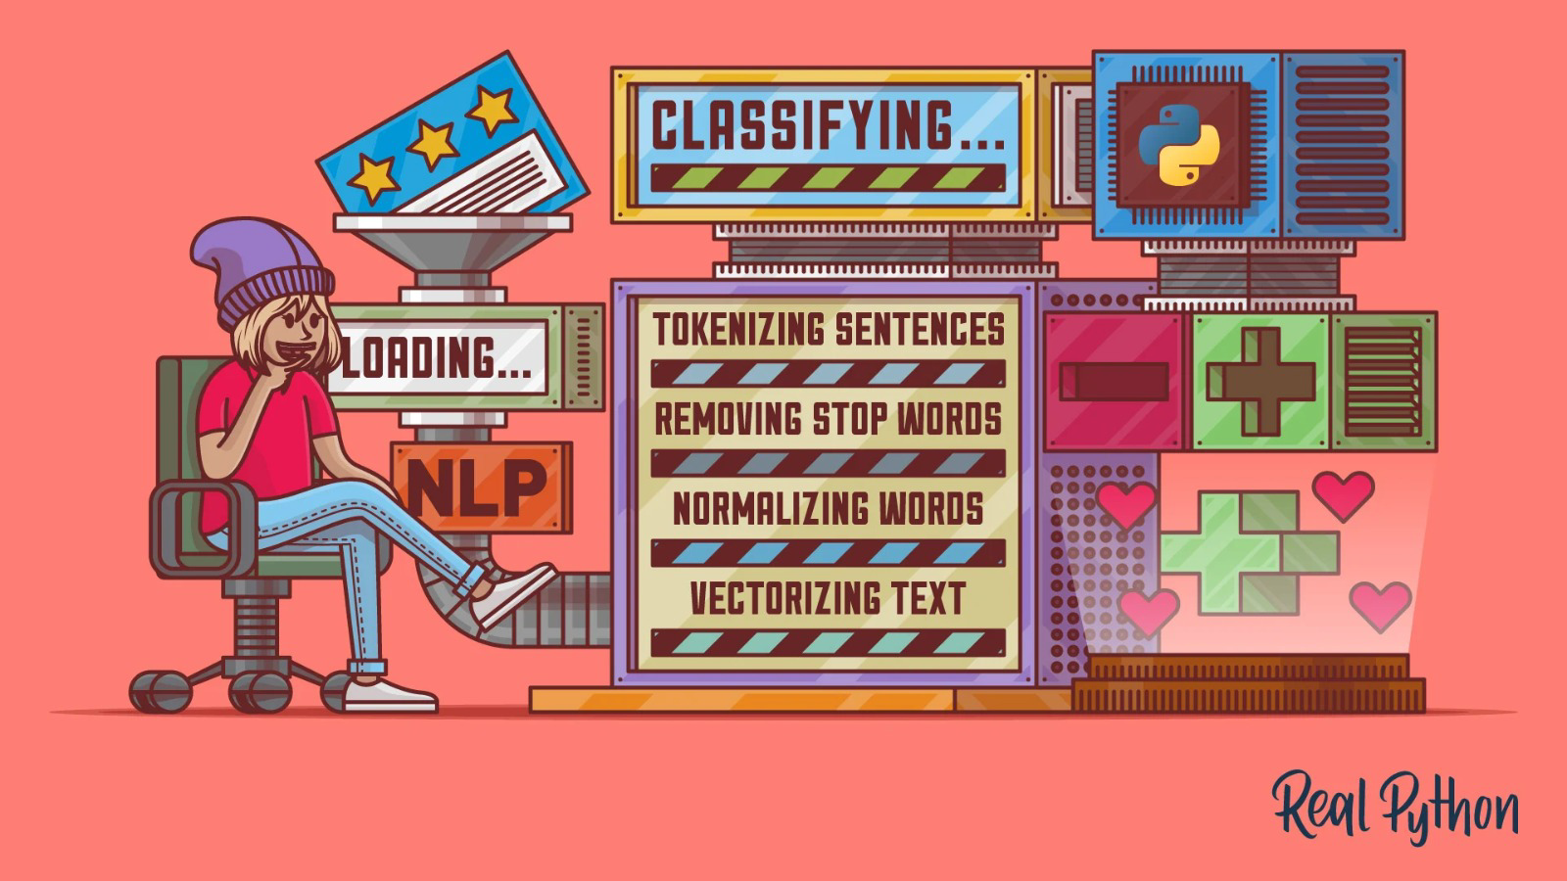
Team working on this
Chandana Nagandla
Pravallika Muraboyina
Rakesh Kumar Dagam
Sai Ram Lohith Nalluri

Slide 3
The Problem
Problem #1 Reading too many reviews or conducting excessive research before seeing the film (as tempting as it may be)
Problem #2 evaluating to let the reader to know whether or not it's worth their time, money, and effort to watch.
Problem #3 evaluating the film's quality with the intention of recommending it for viewing
01
02
03

Slide 4
The Solution
Solution #1 Sentiment analysis of a movie review can help the positive and negative of a movie reviews and hence the overall rating for a movie.
Solution #2 Movie reviews rate the movies which help viewers to decide if the movie is worth watching or not
Solution #3 Sentiment analysis can also determine the attitude of critics depending on their reviews.
01
02
03

Slide 5
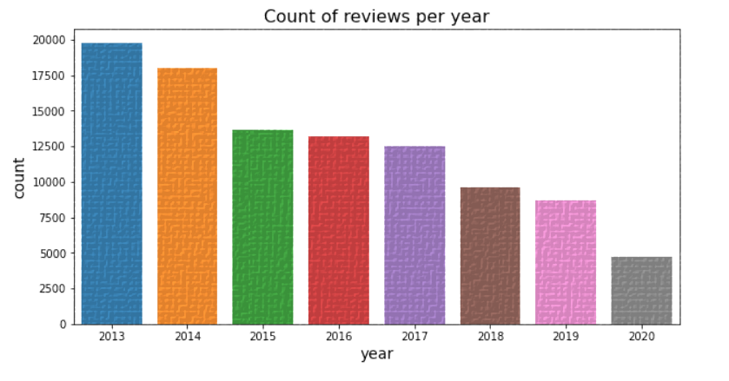
Market Size for movie reviews
Number of people providing reviews per year
2015
198675
2016
180053
2017
134979
160987
2018
109872
98542
88542
2019

Slide 6
Business model / Plan
Pre-processing data
Features
Modelling
Bag of words
Evaluation
Classification
Underlying sentiment of a movie review on the basis of its textual information

Slide 7
Technology/expertise
Exploratory Analysis
The training and test set both including 50, 000 sentiment and movie reviews. In training set we are also given a sentiment of the movie which is 1 if it is positive and 0 otherwise
Sentiment Analysis for Movie Reviews
Feature Extraction
pre-defined set of features from the training data to produce output for the test data.
Models
The overall task in this project is for classification of reviews as favorable or unfavorable. Therefore, for this classification of task, multiple classification models are used for Feature representations. also trained a model based on k-Nearest Neighbors to match the similarity between the reviews and classify them accordingly

Slide 8
Why We are Better?
Data Extraction
&
Feature Extraction
Classification & Evaluation
Sentiment Profile Analysis

Slide 9
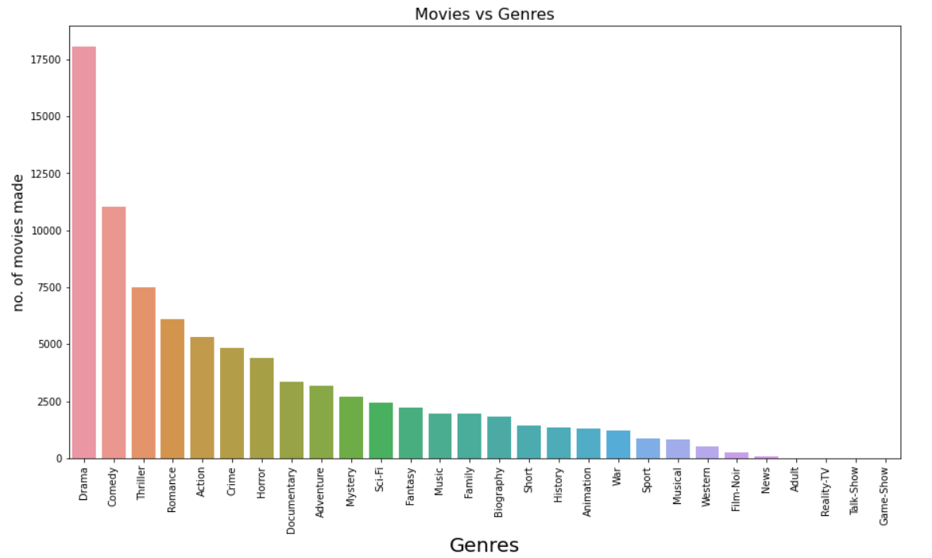
Reviews In order to Acquire the data provided by public information on movie reviews
Kaggle This is a platform where we obtained the required information to work on the analysis.
Analysis This is the part where the obtained data is processed and produce the required results.

Slide 10
Competition

Slide 11
Roadmap, metrics milestones
Review Traffic
Data Collection and cleaning
Data Analysis
The model is analyzed and constructed using a variety of classification algorithms. The most accurately predicted classifiers were KNN and Random Forest.
Monitoring the websites that produce quality and quantity reviews
The NLTK library's stemming and tokenizing methods were used to load and preprocess the IMDB dataset from Kaggle.

Slide 12

Thank you

